Slide 1
APPLICATION INFRASTRUCTURE ON CLOUD

Slide 2
PROJECT REQUIREMENTS
Service Availability
Security
Scalability
Low Cost
Customer satisfaction

Slide 3
CONTENTS
DESIGN
IMPLEMENT IAM
SETUP VPC
IMPLEMENT APPLICATION
ANSIBLE
IMPLEMENT MONITORING

Slide 4
DESIGN

Slide 5
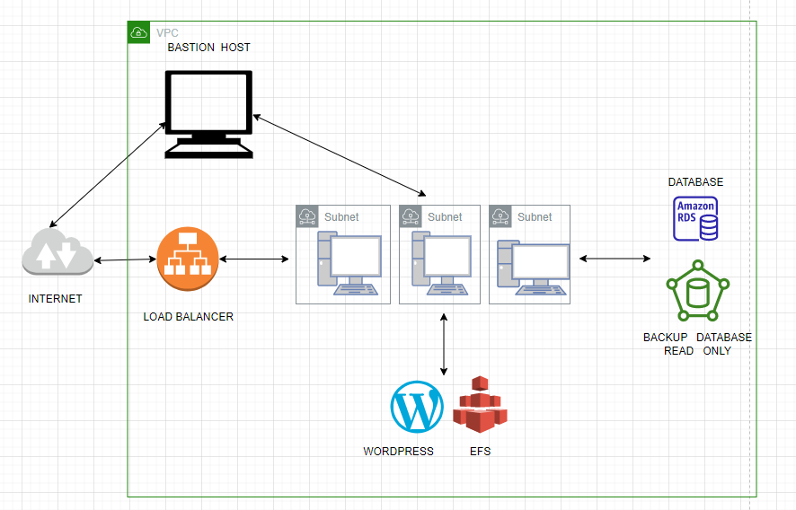

Slide 6
SETUP VPC

Slide 7
OBJECTIVE
VPC
SUBNETS
INTRENET GATEWAY
NAT GATEWAY
ROUTE TABLE

Slide 8
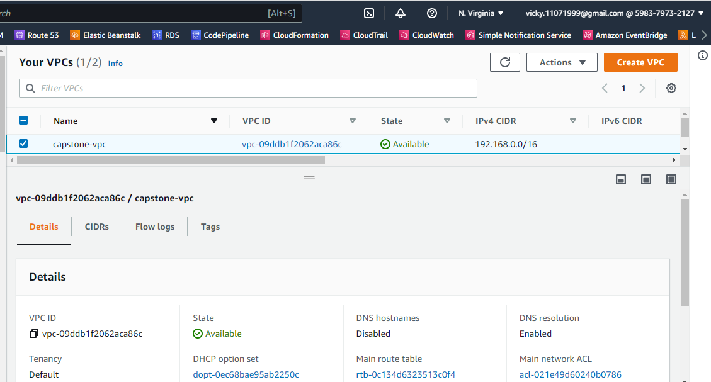

Slide 9
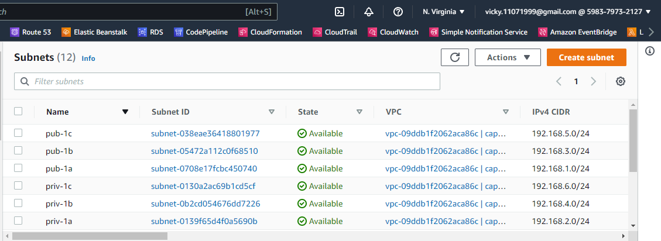

Slide 10
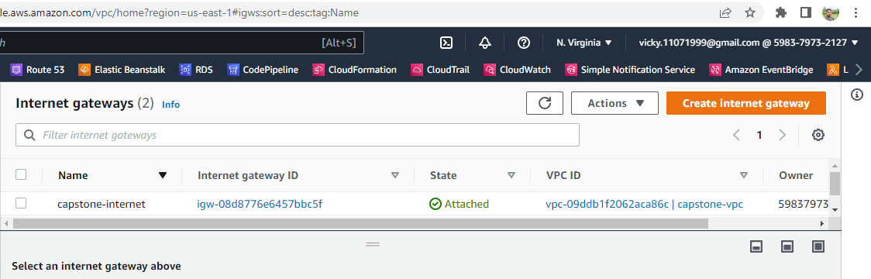

Slide 11
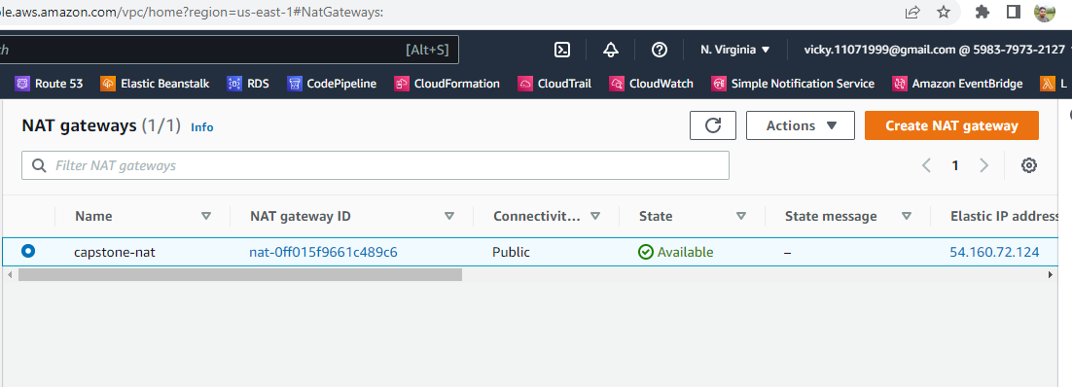

Slide 12
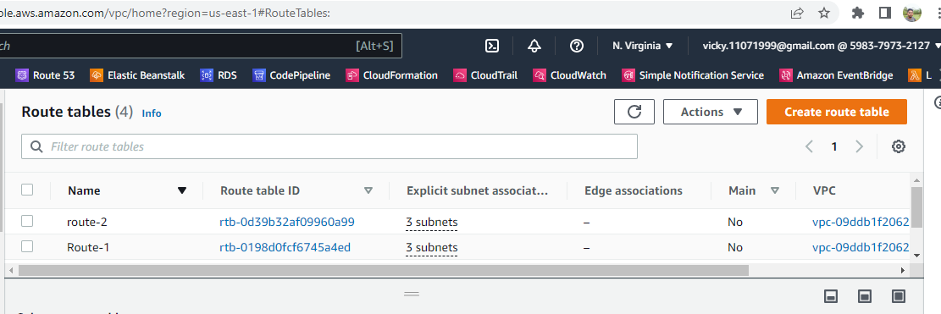

Slide 13
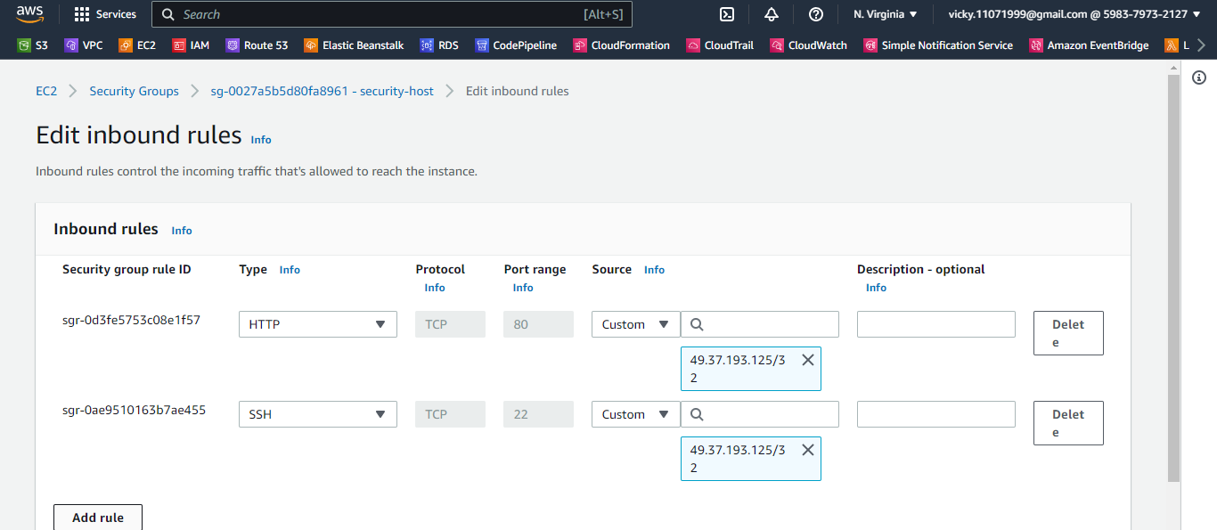

Slide 14
Implement Application

Slide 15
STEPS:
EC2 Instances
RDS
EFS
WordPress
Load Balancer
Auto Scaling

Slide 16
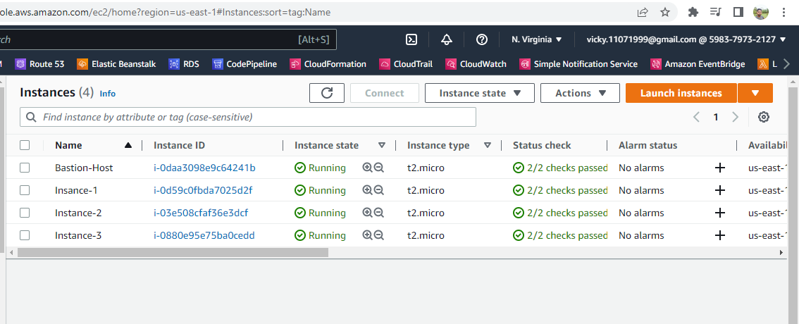

Slide 17
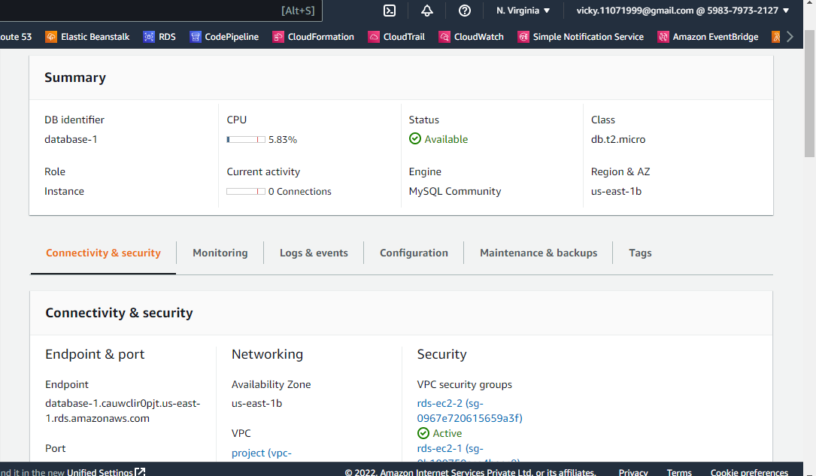

Slide 18
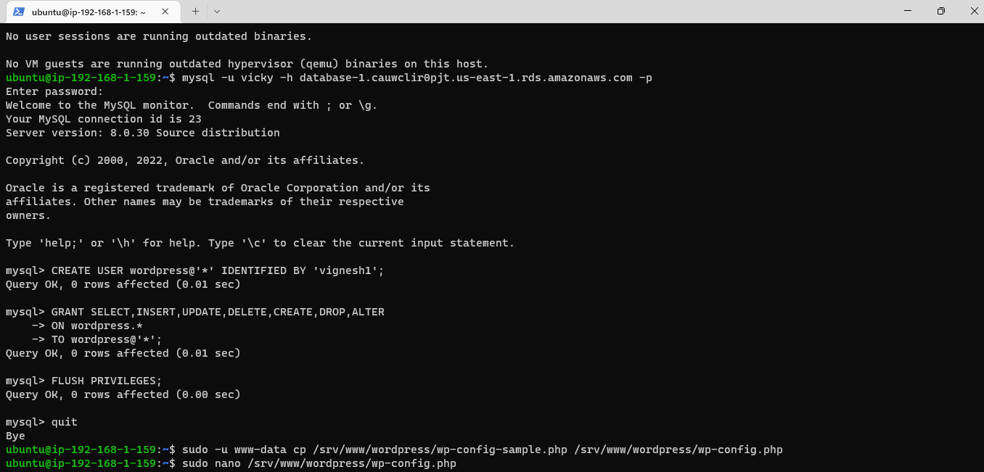

Slide 19
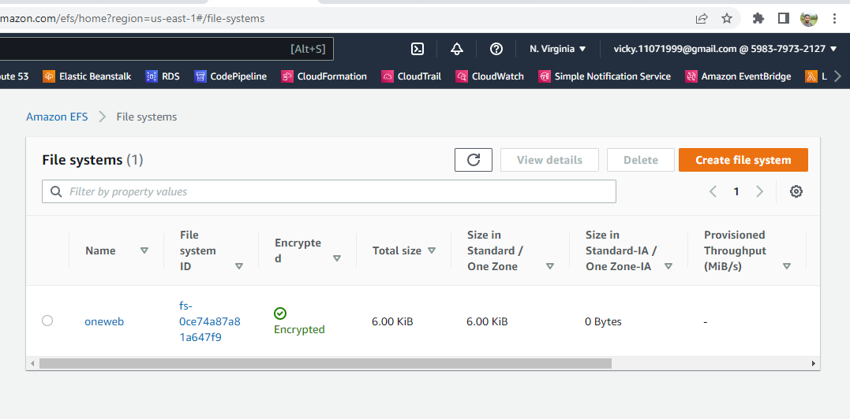

Slide 20
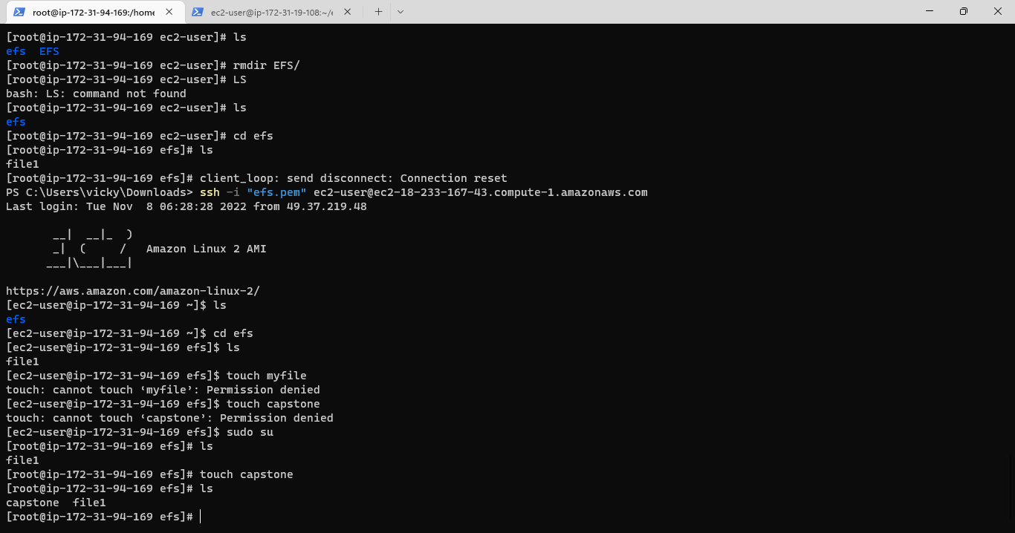

Slide 21
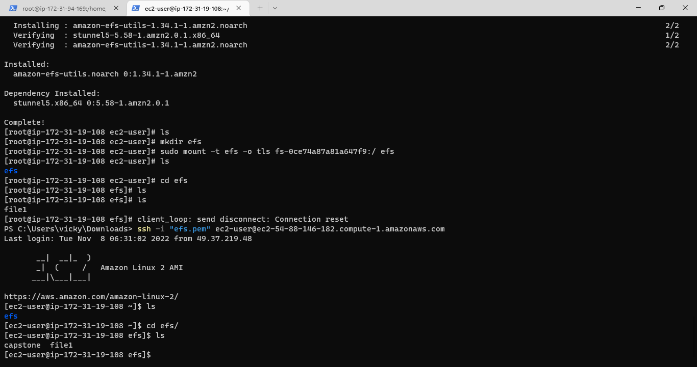

Slide 22
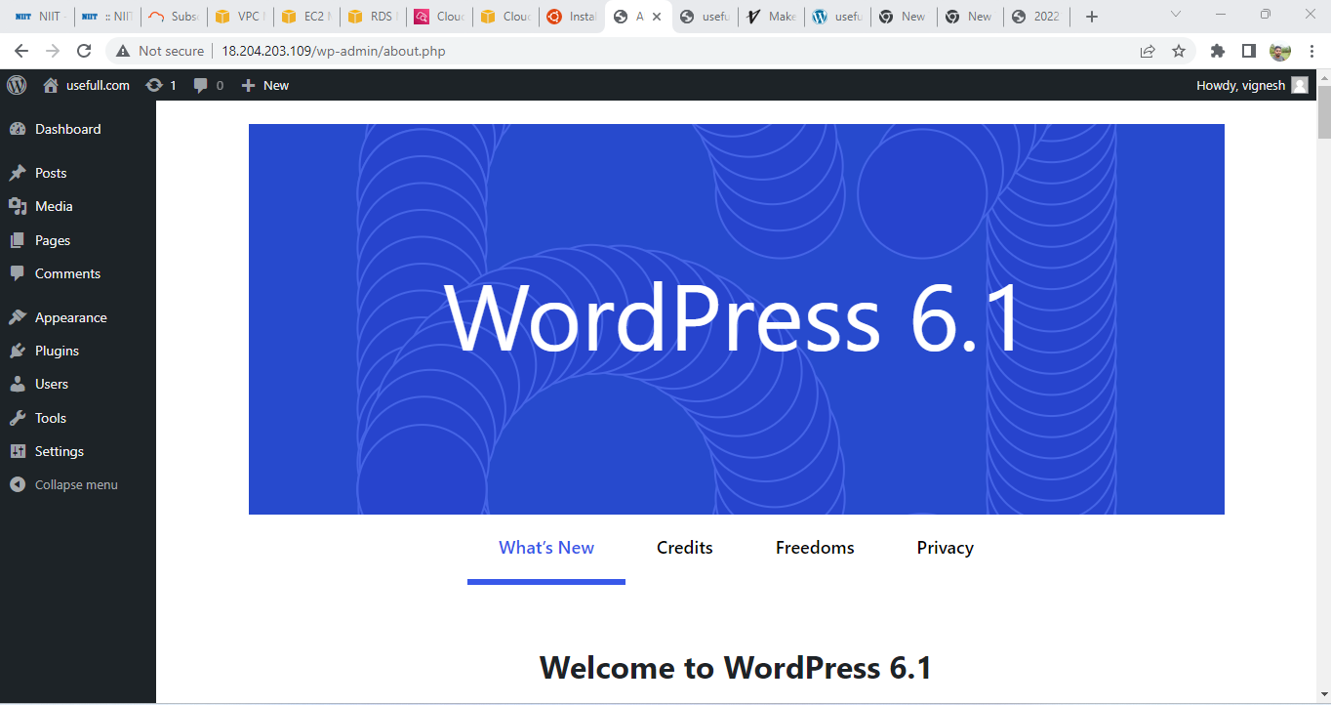

Slide 23
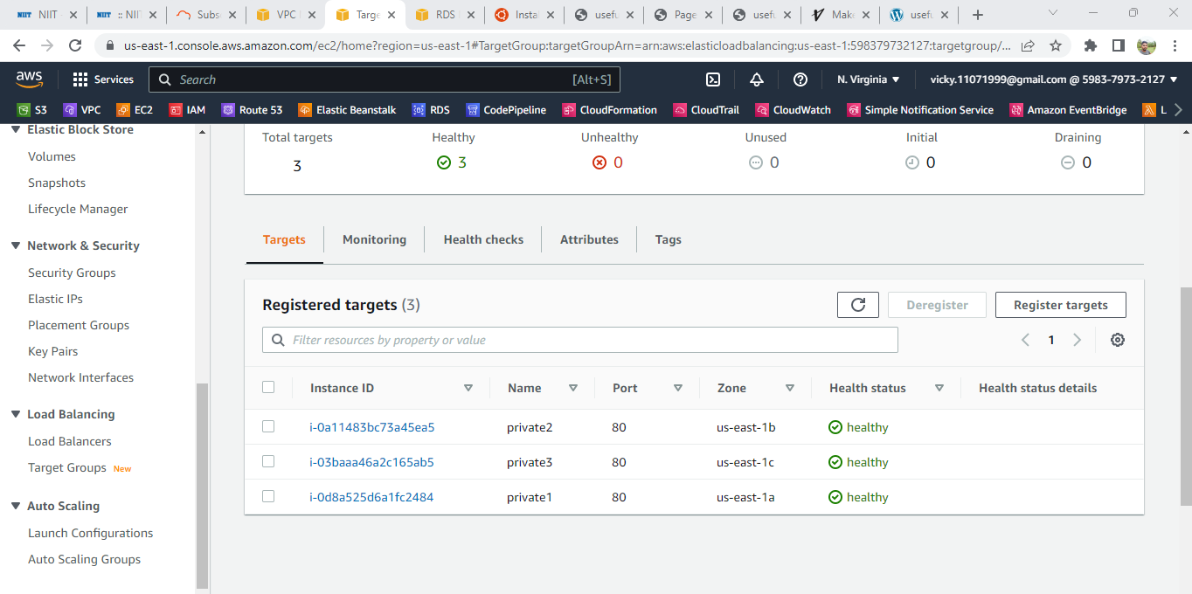

Slide 24
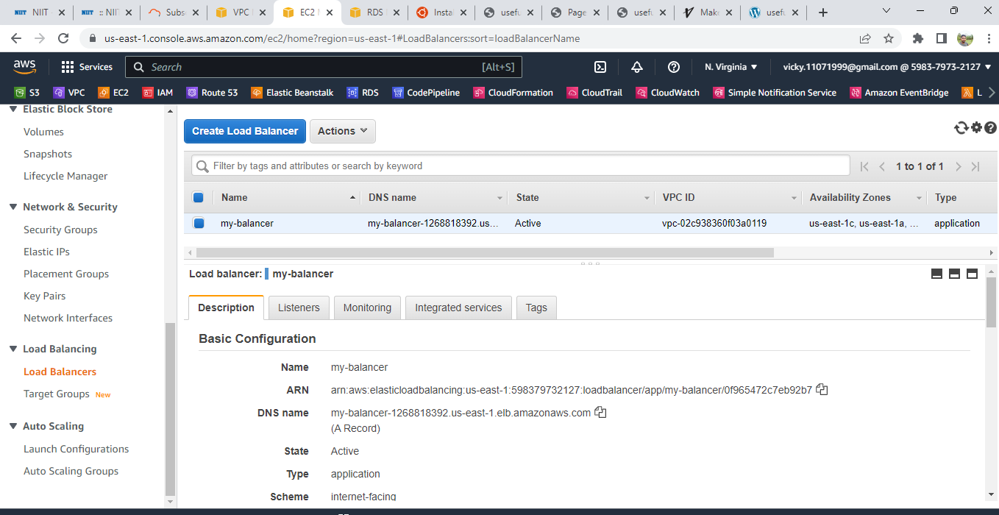

Slide 25
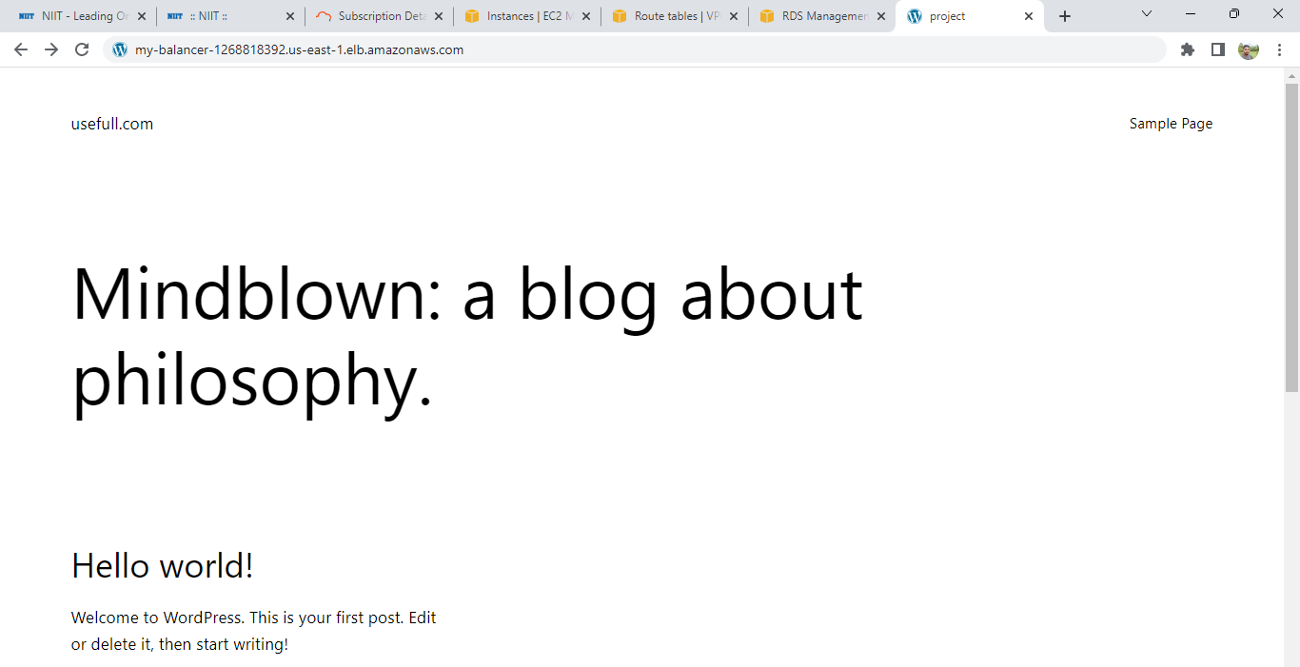

Slide 26
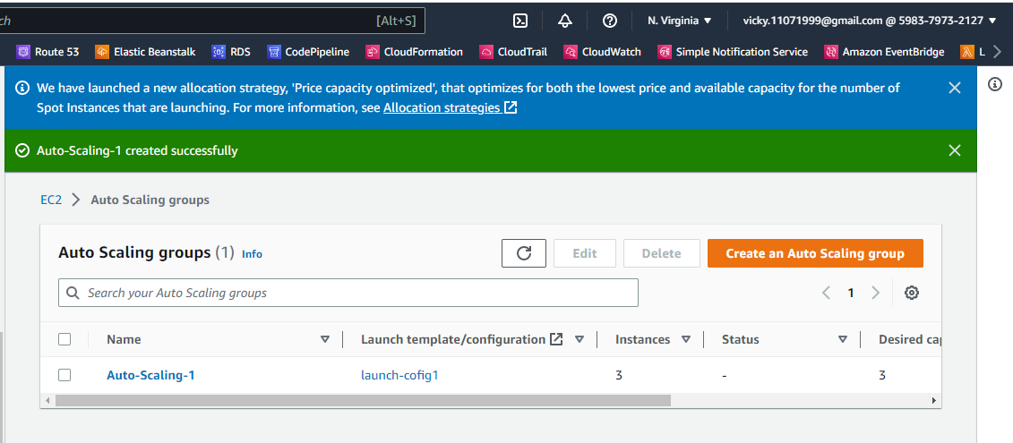

Slide 27
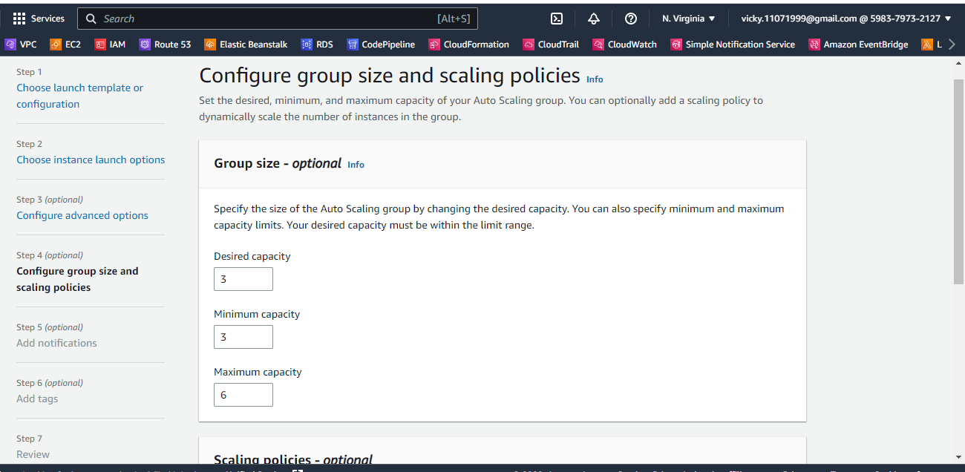

Slide 28
ANSIBLE

Slide 29
OBJECTIVE
MOTD Template
Create users and group

Slide 30
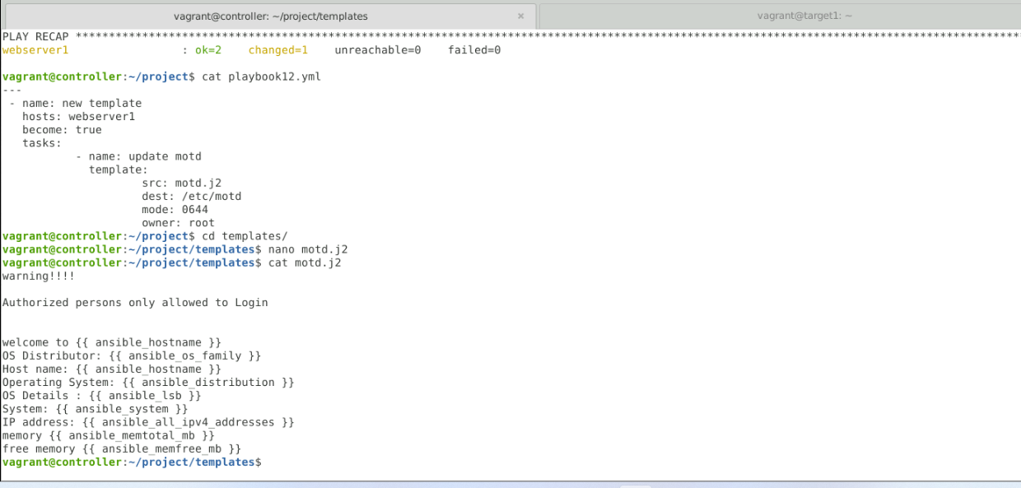

Slide 31
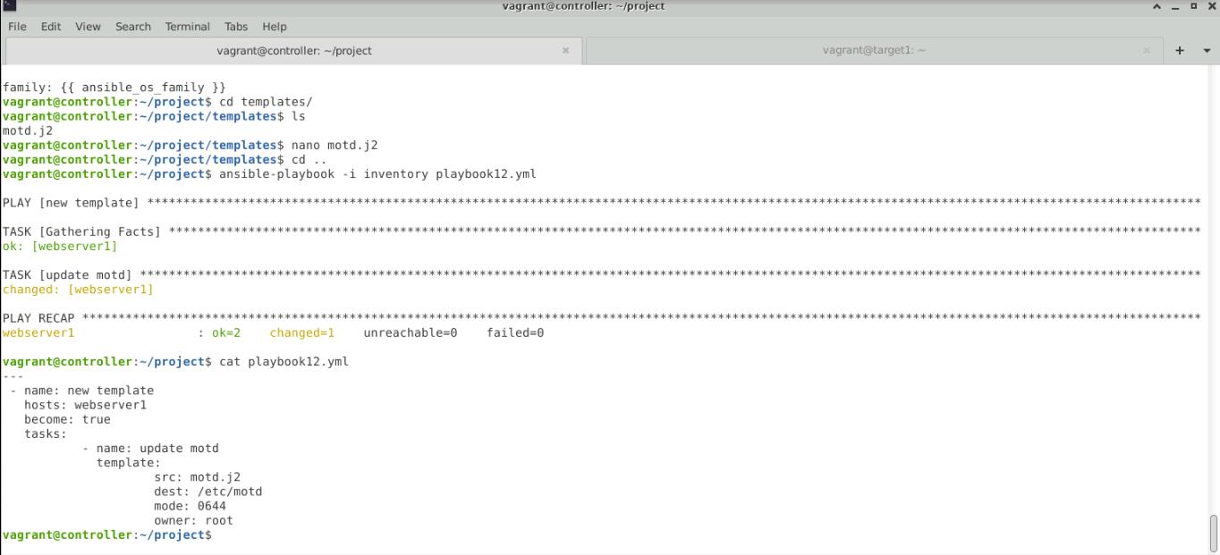

Slide 32
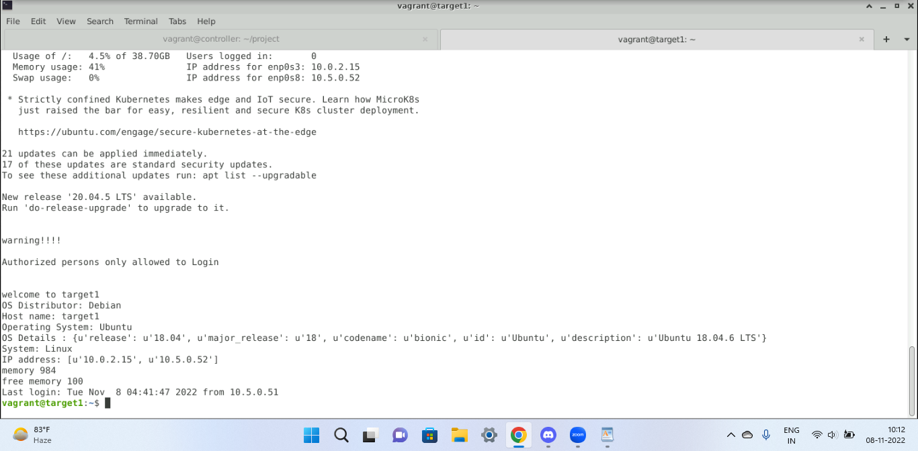

Slide 33
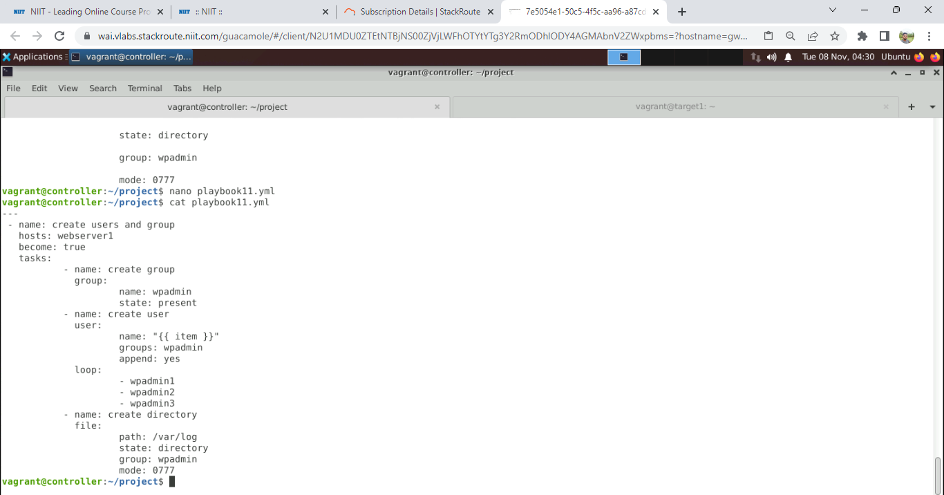

Slide 34
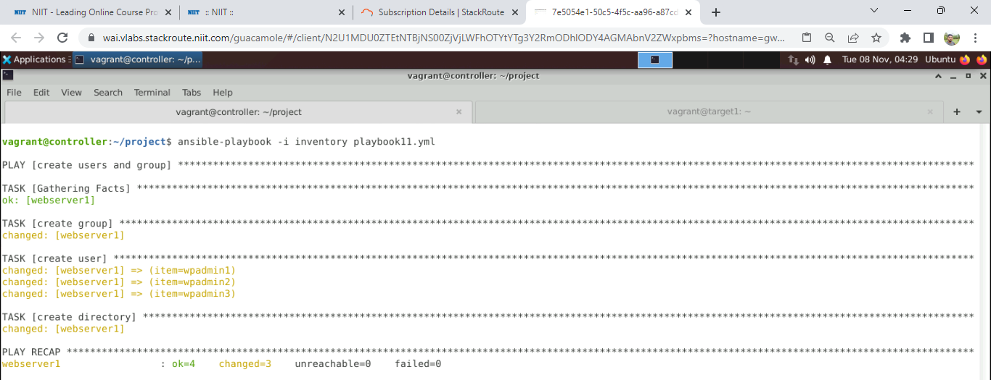

Slide 35
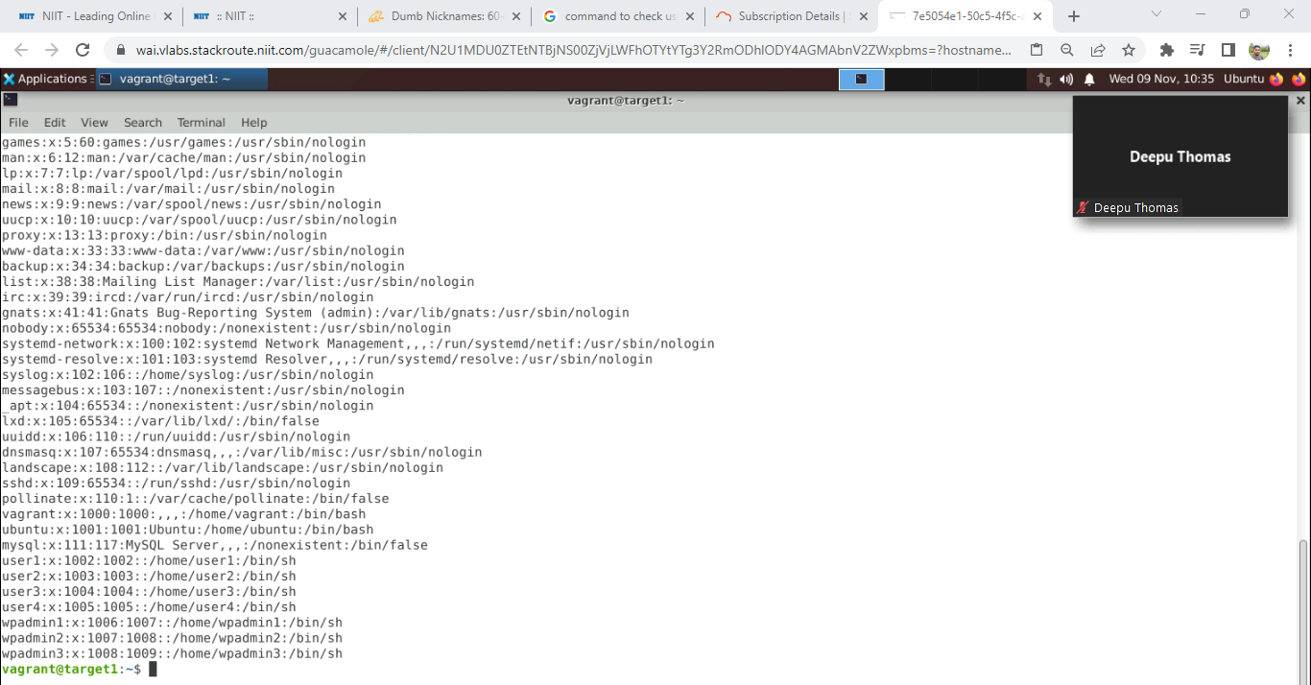

Slide 36
IMPLEMENT IAM

Slide 37
REQUIREMENTS
GROUP NAME | ROLE
Software Admin | Code Pipeline full access Administrator access – Elastic Beanstalk
Database Admin | RDS full access
Log Admin | CloudWatch full access
Network Admin | VPC full access
EC2 Admin | EC2 full access

Slide 38
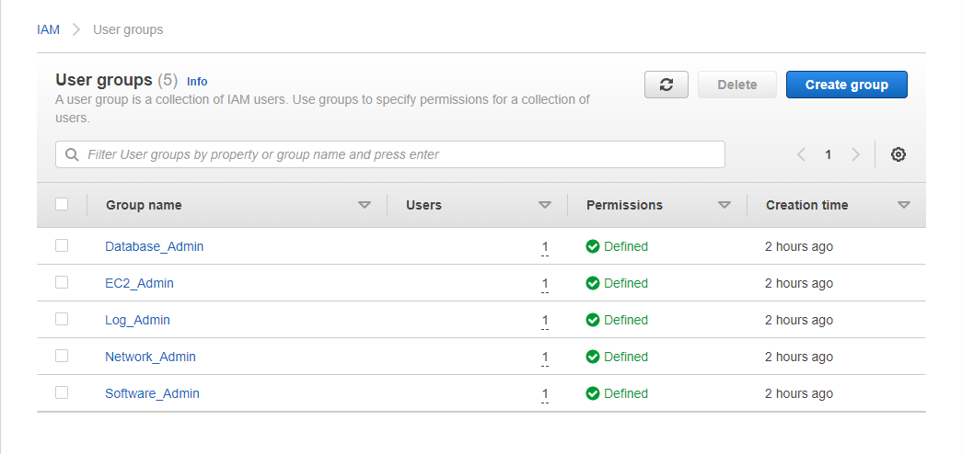

Slide 39
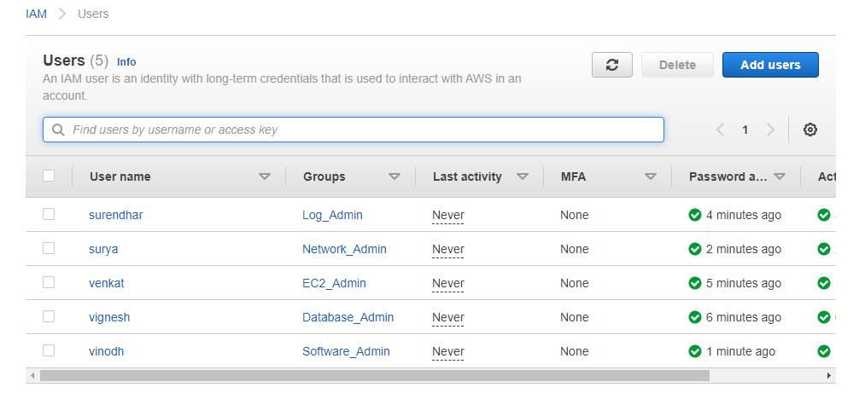

Slide 40
IMPLEMENT MONITORING

Slide 41
OBJECTIVE
Cloud Watch Monitoring
Alarm Set-Up
Cloud Trail Log Monitoring
S3 Health Check

Slide 42
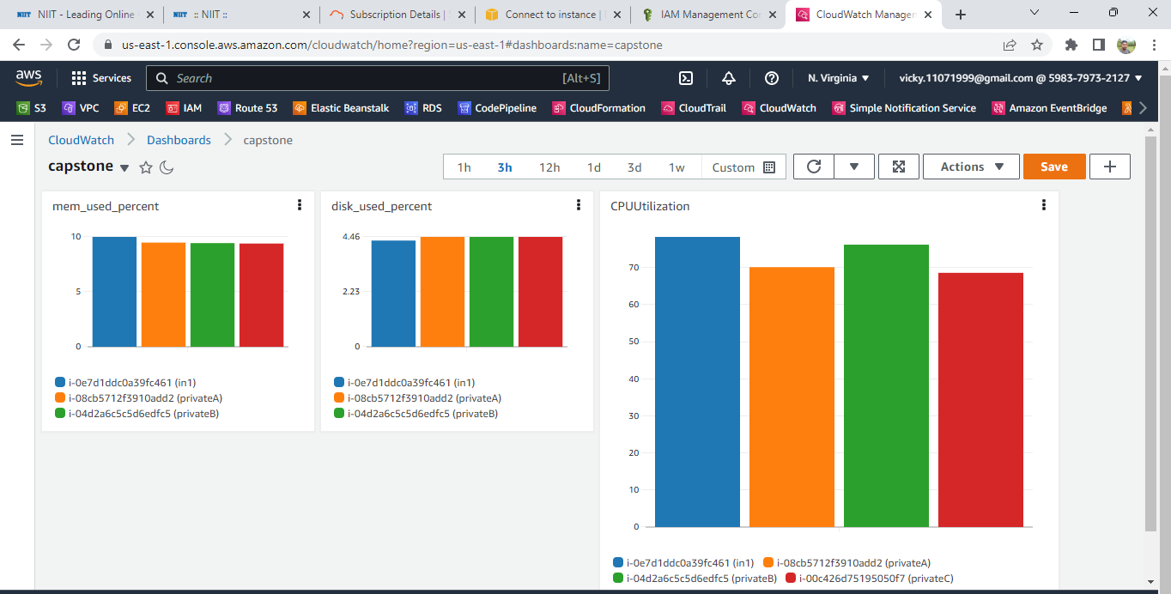

Slide 43
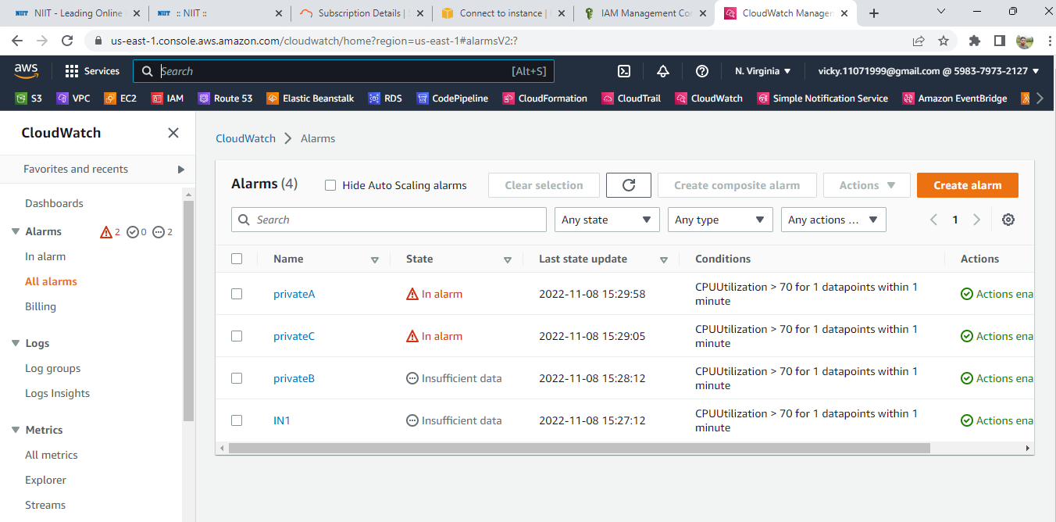

Slide 44
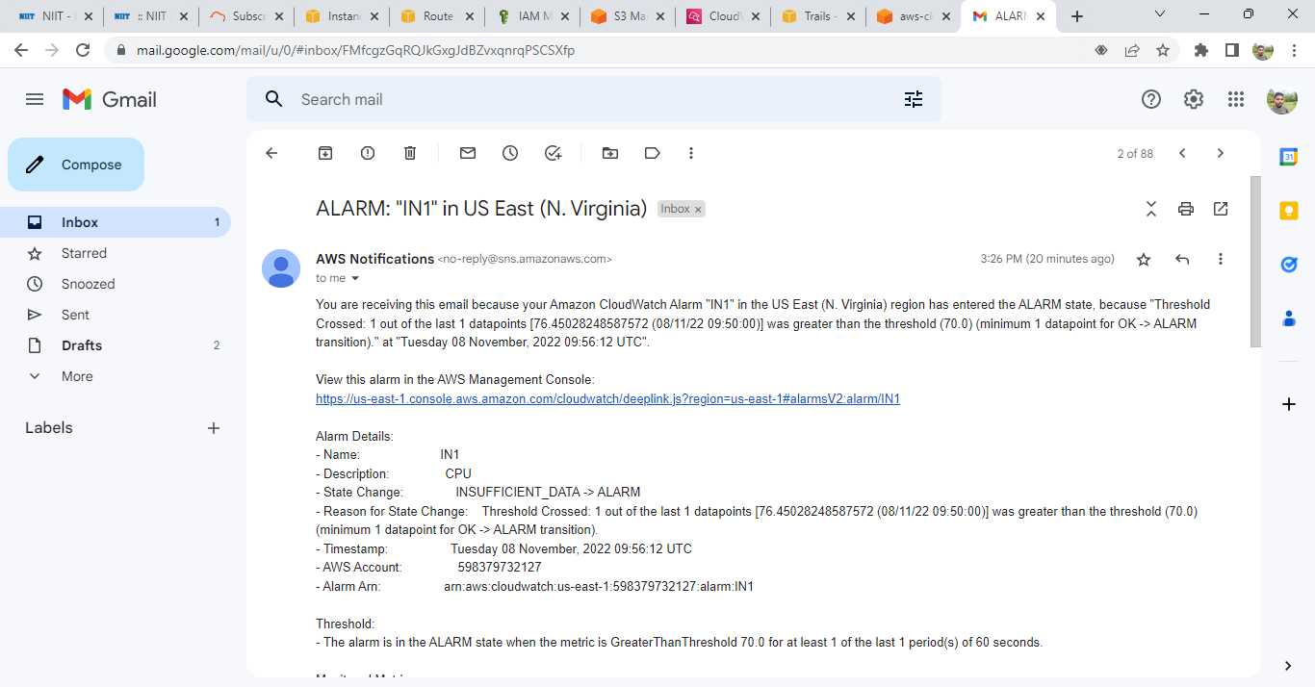

Slide 45
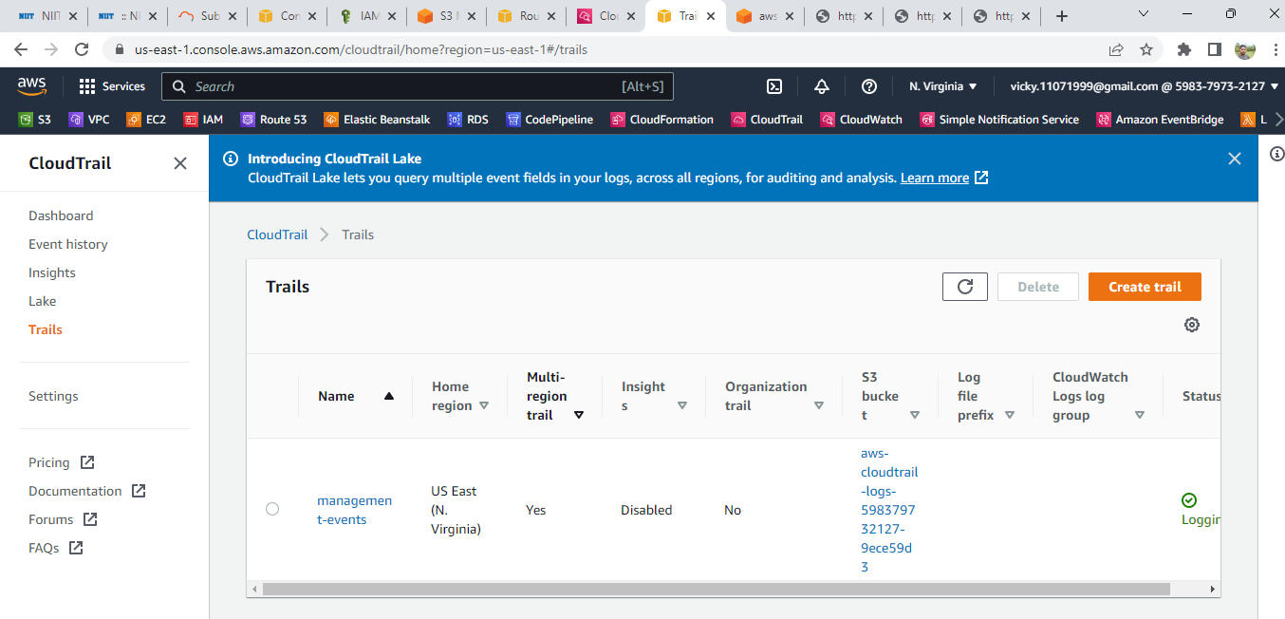

Slide 46
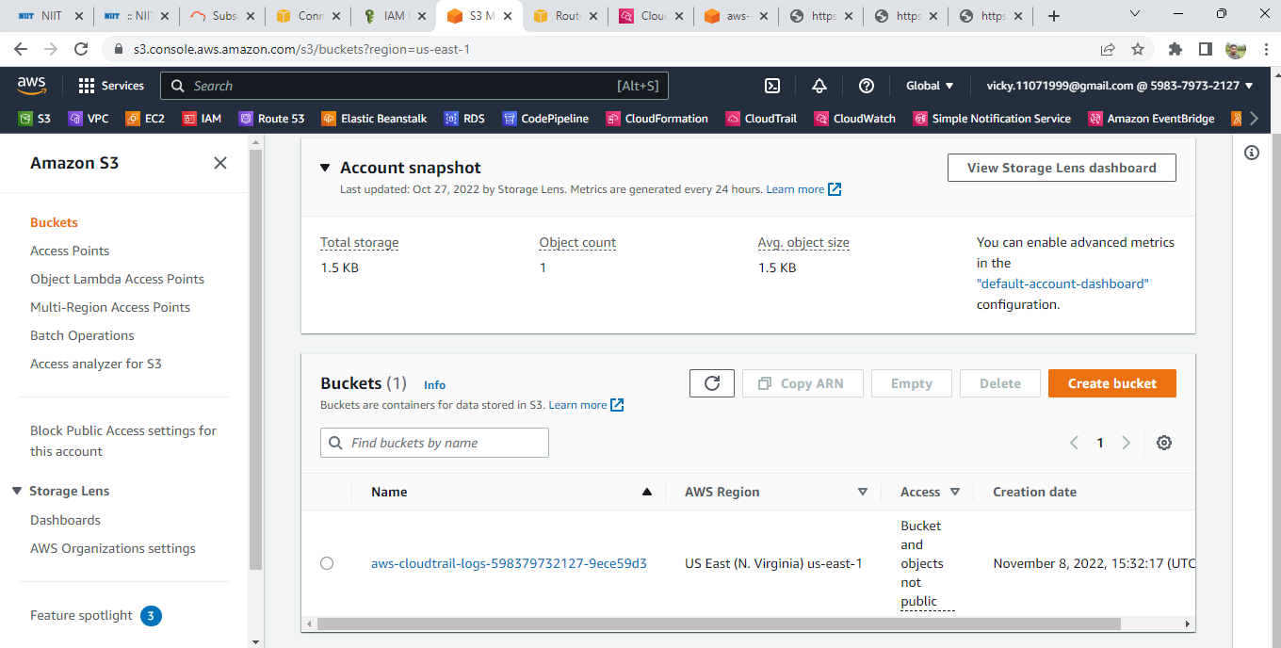

Slide 47
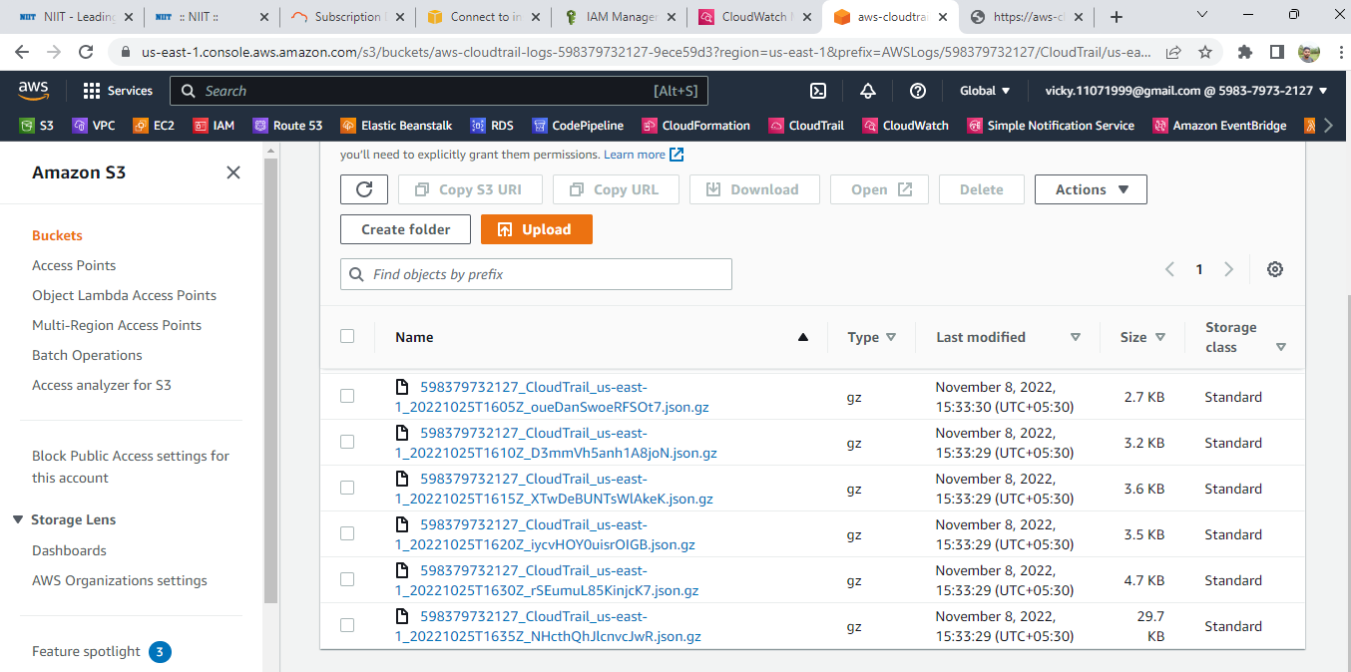

Slide 48
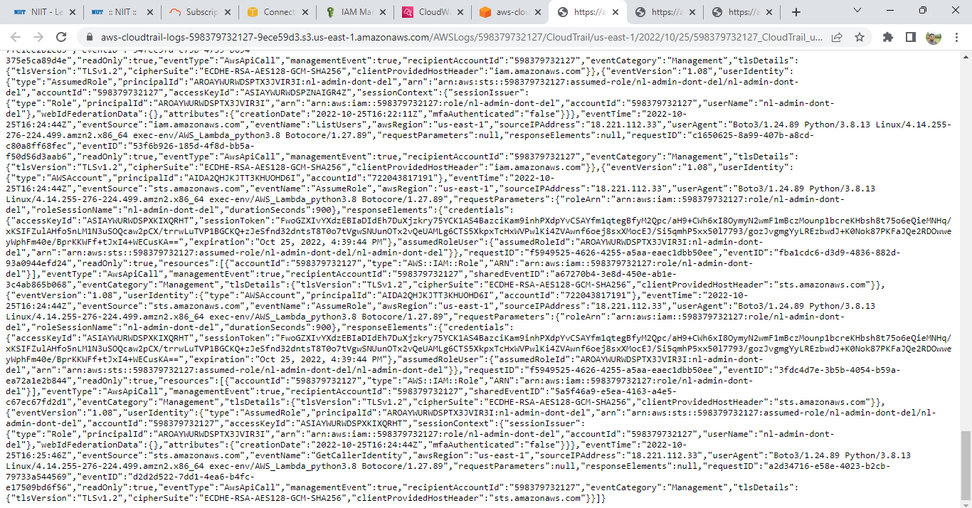

Slide 49
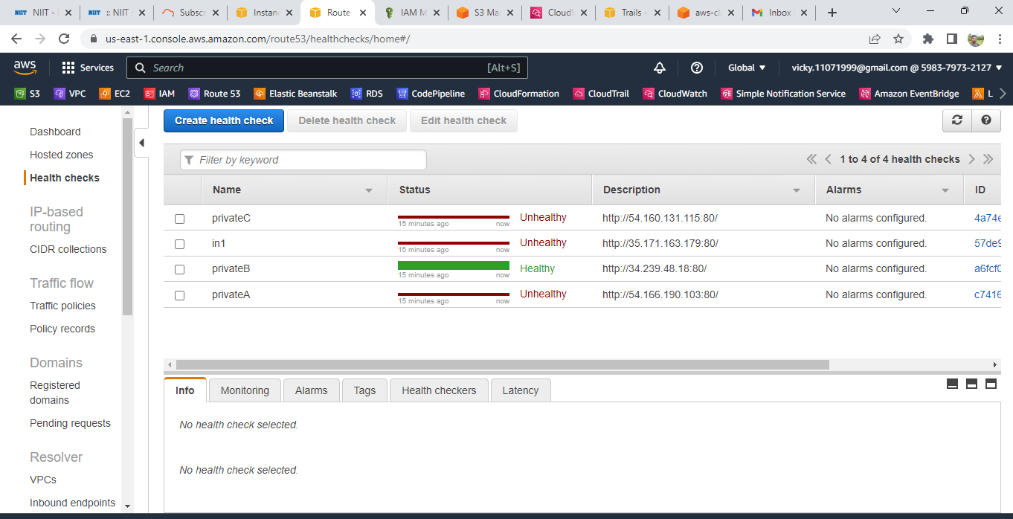

Slide 50


